Slide 1
Predicting Customer Ride Cancellations
A Machine Learning Approach to Rideshare Marketplace Behavior
Amy Yunyu Chiang
Machine Learning Final Project

Slide 2
Research question
Can we predict whether a customer will cancel a ride?
Can customer cancellation be predicted using information available around the booking?
Focus on a binary outcome: customer cancellation vs. completed ride.
Compare three machine-learning approaches:
  Logistic Regression
  Linear Support Vector Machine (SVM)
  XGBoost
2

Slide 3
Data and analytic sample
150,000
original rides
103,500
analytic sample
10.1%
customer cancellation rate
30%
held-out test set
Original dataset: 150,000 bookings and 21 variables.
Primary analysis retained only Completed (93,000) and Cancelled by Customer (10,500) rides.
Driver cancellations, No Driver Found, and Incomplete bookings were treated as distinct marketplace outcomes and excluded from the primary binary analysis.
Final outcome: 1 = Cancelled by Customer; 0 = Completed.
3

Slide 4
Predictor selection: avoid target leakage
I excluded variables that directly reveal the outcome or are generally observed after the ride.
Excluded: cancellation/reason fields, incomplete-ride fields, driver/customer ratings, IDs, and other post-outcome variables.
Avg CTAT and Booking Value were excluded because they were unavailable for customer-cancelled rides in this dataset.
Conservative first model used:
  Avg VTAT
  Hour and day of week
  Vehicle type
  Pickup and drop-off location
4

Slide 5
Feature engineering and preprocessing
Date and time were converted into booking-time features.
Created hour, day of week, month, weekend indicator, and peak-hour indicator.
Numeric variables: median imputation based on the training data, followed by standardization.
Categorical variables: one-hot encoded with unseen test categories handled safely.
Used a 70/30 train-test split with the same held-out test set for all three models.
5

Slide 6
Three models
Logistic Regression
Interpretable linear baseline
Class-weighted to address outcome
imbalance.
Linear SVM
Linear decision boundary
Class-weighted and suited to the
high-dimensional encoded feature space.
XGBoost
Tree-based boosting
Captures nonlinear relationships and
interactions; class weighting addresses
imbalance.
6

Slide 7
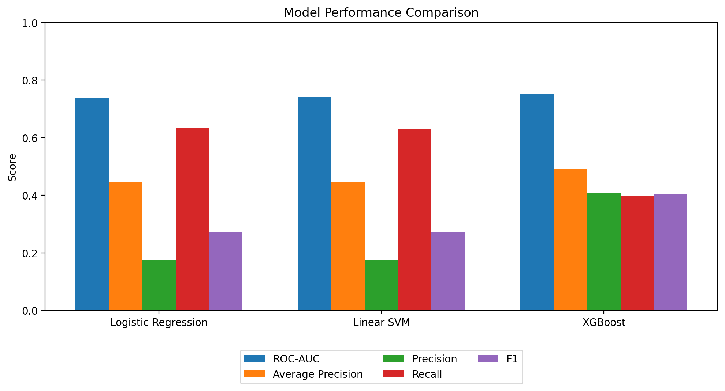
Model performance
7

Slide 8
Why XGBoost was preferred
0.752
ROC-AUC
0.492
Average Precision
0.403
F1 score
88.0%
accuracy
XGBoost achieved the highest ROC-AUC, Average Precision, precision, F1, and accuracy.
At the default 0.5 threshold: precision = 40.7%, recall = 39.9%.
Logistic Regression and Linear SVM had recall around 63%, but precision around 17%, producing many false positives.
Because cancellations are relatively uncommon, accuracy alone should not determine model selection.
8

Slide 9
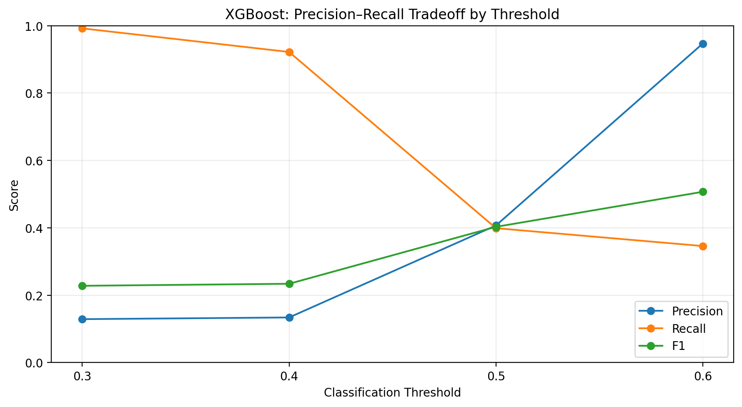
XGBoost threshold analysis
Threshold 0.3: recall 99.2%, precision 12.9%
Threshold 0.5: recall 39.9%, precision 40.7%
Threshold 0.6: recall 34.6%, precision 94.7%, F1 0.507
The 0.6 threshold had the highest F1 among the four tested thresholds.
Threshold choice depends on whether the priority is finding more cancellations or making fewer false alerts.
9

Slide 10
Key takeaways and next steps
Customer cancellation can be predicted with moderate discrimination using booking-level features.
XGBoost provided the strongest overall performance among the three tested models.
Linear models prioritized recall, while XGBoost offered a better balance of precision and recall.
Classification threshold is a practical decision lever: lower thresholds catch more cancellations; higher thresholds produce more confident alerts.
Next steps: test additional thresholds, validate performance with cross-validation, and evaluate whether more booking-time features are legitimately available without leakage.
10

